Slide 1
ROCKETMAN: A destructible Grid-Based Shooter
Team DAAMN:
Darrian Ward, Ashton Trumble, Andrew Key, Mason Red, Noble Webb

Slide 2
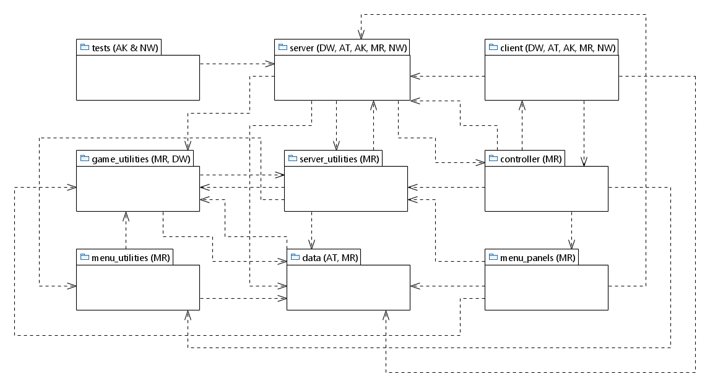
Package Diagram
All dotted lines represent an <<import>>
Notes:
tests imports “server”
controller imports: “server”, “menu_panels”, “menu_utilities”, “game”, and “data”
data imports “game_utilities”
game imports “controller”, “data”, “menu_panels”, and “server”
game_utilities imports “server_utilities” and “data”
menu_panels imports “menu_utilities”, “game_utilities”, “server”, “server_utilities”, and “data”
menu_utilities imports “game_utilities”, “data”
server imports “controller”, “data” , “game_utilities”, and “server_utilities”
server_utilities imports “data”, “game_utilities”, “menu_utilities”, “server”

Slide 3
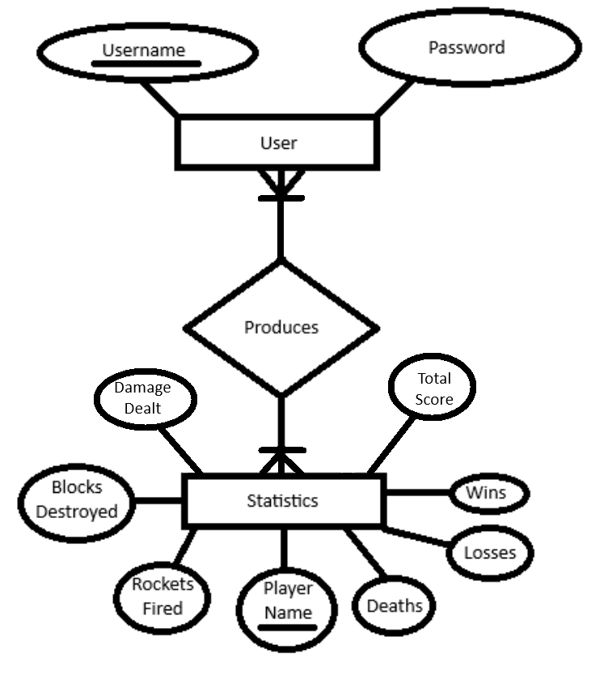
Database Design – ER Diagram

Slide 4
Example – Functional Requirements
Players must be able to control their characters using WASD keys for movement and a mouse for aiming and firing rockets (Movement, Aiming, and Shooting)
The game environment must have a destructible grid-based terrain that reacts to player actions and interactions (Environment Interaction)

Slide 5
Example – Use Case Descriptions
Use Case: Movement
Actor: Player
Player taps the WASD keys for directional movement
The system sends the player’s input to the server
The server registers the player’s input and signals the system to move the player’s position
The player’s character moves in the direction they input
Entry Condition: Player attempts to move
Exit Condition: Player moves in the direction that they input
Use Case: Aiming/Shooting
Actor: Player
Player moves their cursor across the game UI and eventually clicks the left-mouse button.
The system sends these actions to the server
The server registers these movements and signals the system to act accordingly
The player shoots a rocket towards the position of their cursor
Entry Condition: Player aims and fires
Exit Condition: Player’s tank fires rocket where they were aiming
Use Case: Destruction of Environment/Collision Detection
Actor: Player
Player clicks the left-mouse button to shoot a rocket
The system signals the server that the player fired a rocket
The server informs all clients about the rocket and its position
The rocket comes into contact with a block
The server recognizes the rocket’s contact with the block and removes it
The server tells each client which block was destroyed by the rocket
The change in the game environment is reflected across all clients
Entry Condition: Player’s rocket comes into contact with destructible environment
Exit Condition: Environment breaks

Slide 6
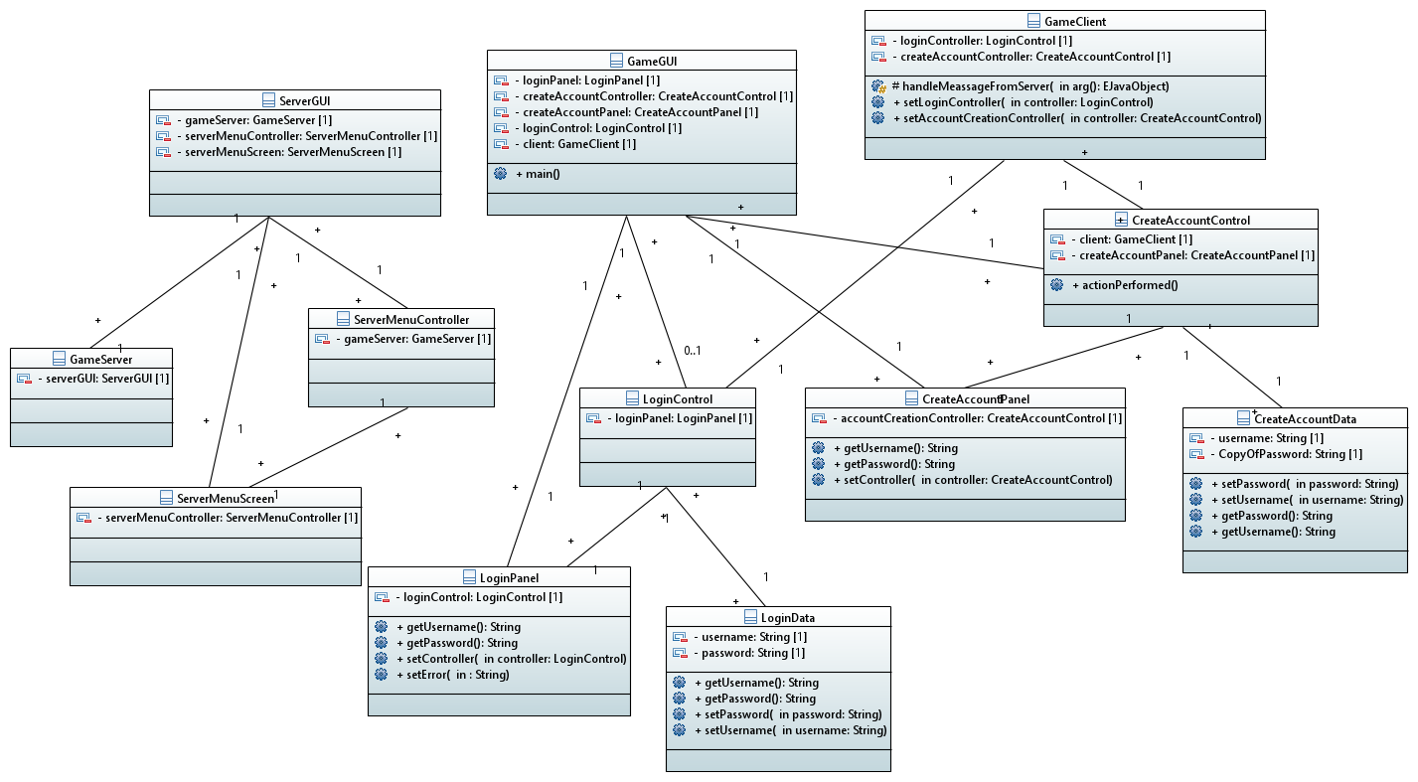
Example – [Initial] Class Diagram

Slide 7
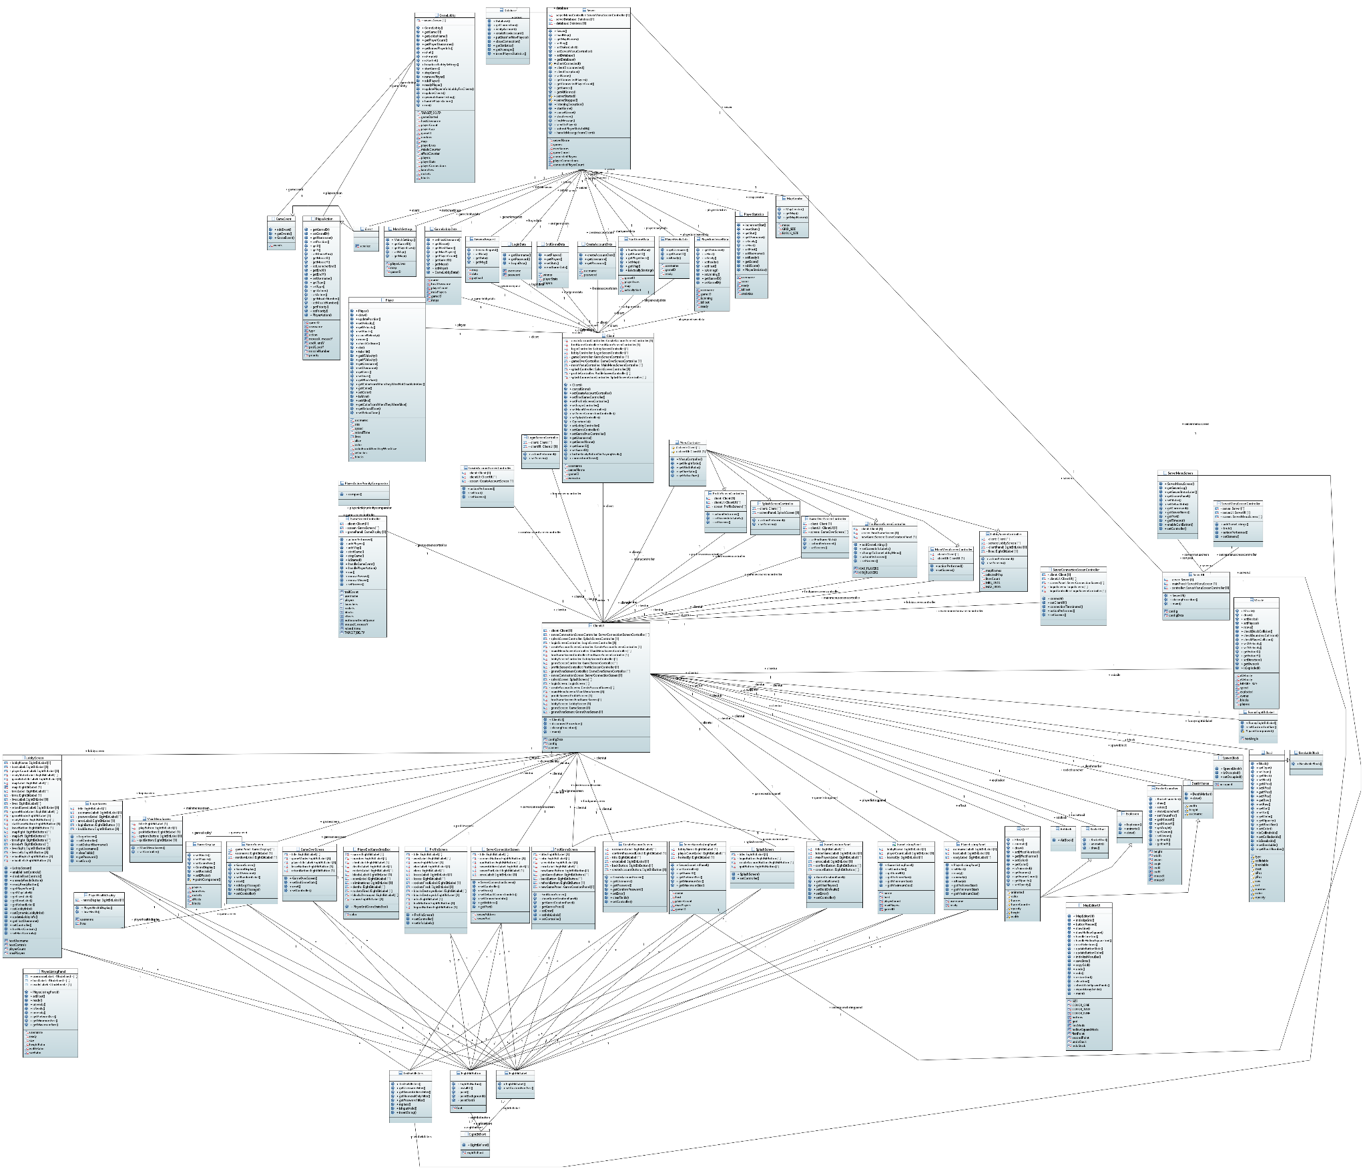
Example – [Final] Class Diagram

Slide 8
!!! TIME FOR THE GAME DEMO !!!

